Slide 1
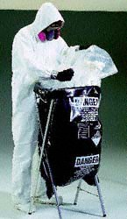
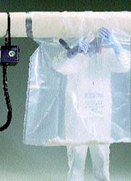
ASBESTOS AWARENESS

Slide 2
TRAINING OUTLINE
What is Asbestos?
Health Effects Associated with Exposure
Defense Mechanisms
Smoking
Locations of ACBM and ACM
Recognition of Damage
Emergency Procedures and Contacts
Rules and Regulations
Abatement
Operations & Maintenance (O&M)
Questions and TEST
Notes:
This is an outline of what we are going to cover today. If you notice we will have an opportunity for questions at the end of the presentation but if you have any while we are covering a specific topic, please go ahead and ask. We will have a short quiz at the end of the program so please make sure you understand everything we cover.

Slide 3
Training Requirements
Annual Awareness Training
Asbestos-Uses and Forms
Location of ACBM
Recognition of Damage
Names and Telephone Numbers of Program Manager and Emergency Personnel
Notes:
All employees who work in areas where they may encounter asbestos-containing materials must receive a 2 hour awareness level training. That is what we are doing today. There is certain information that must be provide during this training and that includes: What asbestos is, its forms and where it is found on campus. Also, how to recognize damaged material and what to do and who to contact when this happens.
For those employees who participate in the University’s In-House Operations and Maintenance Program where they actually have to perform small-scale removal of asbestos-containing material, they must receive an additional 14 hours of training.

Slide 4
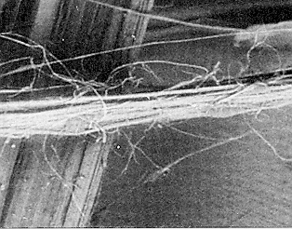
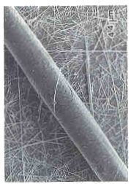
WHAT IS ASBESTOS?
Naturally Occurring Mineral
Chrysotile, Amosite, and Crocidolite
>3,000 Building Products
Surfacing Material, TSI and Miscellaneous
Desirable Physical Properties
ACM >1% Asbestos
Laboratory Analysis
Notes:
The term asbestos describes naturally occurring fibrous minerals found in certain types of rock formations. Asbestos is mined in much the same way that other materials, such as iron, lead, and copper are. There are many varieties of asbestos: the three most common are chrysotile, amosite, and crocidolite. Asbestos is contained in more than 3,000 different building products. These include thermal insulation (pipe and boiler insulation), fireproofing, floor coverings, ceiling tile, cement pipe, and acoustical and decorative treatment for ceilings and walls. Asbestos fibers are mixed during processing with material which binds them together so they can by used in various applications. Asbestos became a very popular commercial product because it was a relatively inexpensive, virtually indestructible material with desirable physical properties including chemical resistance, incombustibility, thermal insulating ability, electrical insulating ability, mechanical strength, flexibility and good friction and wear characteristics. The amount of asbestos in these products varied widely from less than 1 percent to nearly 100 percent but any material with at least 1 percent asbestos is considered to be an asbestos-containing material (ACM). While it is often possible to “suspect” that a product or material contains asbestos by visual determination, actual determinations can only be made by instrumental analysis. Until a product is tested, it is best to assume that the product contains asbestos.

Slide 5
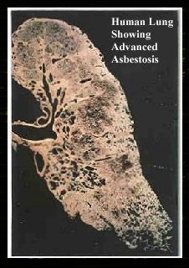
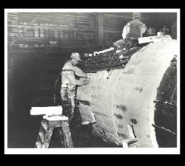
HEALTH HAZARDS
Inhalation Hazard
Must Be Disturbed
Asbestosis
Lung Cancer
Mesothelioma
Latency Period (15 to 40 years)
Risk - Level and Duration of Exposure
Notes:
Although asbestos is an excellent building material, it can also cause serious health problems if it is inhaled. In order for asbestos fibers to be inhaled, they must become airborne. Intact, undisturbed material does not pose a health risk. So in order for asbestos to be an inhalation hazard is if the material is somehow disturbed. The three illnesses most commonly associated with asbestos exposure are asbestosis (non-cancerous scarring of lung tissue), lung cancer and mesothelioma (rare form of cancer which affects the lining of the lungs). These diseases do not develop immediately after inhalation but may take 15 to 40 years before symptoms appear. This is called the “latency period”. Most cases of severe health problems resulting from asbestos exposure have been experienced by workers who held jobs in industries such as shipbuilding, mining, milling, and fabricating, where they were exposed to very high levels of asbestos. Regardless, appropriate measures must be taken to minimize exposure.

Slide 6
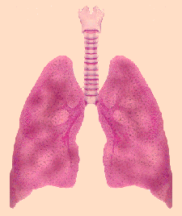
DEFENSE MECHANISMS
Nose and Mouth
Mucous Lined Breathing Passages
Cilia
Notes:
The body has natural defense mechanisms which help eliminate asbestos fibers and other particles before they become lodged in the lung tissue where the contaminants remain. Many particles are stopped by the nose and mouth. The breathing passages are lined with a sticky mucous layer that traps small particles. Lining the bronchial tubes are hair-like projections (cilia) that continuously move the mucous layer towards the mouth for expectoration.

Slide 7
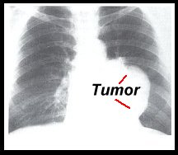
SMOKING
Impairs Body’s Defense Mechanism
Increased Risk of Lung Cancer
Notes:
How many of you currently smoke? Well I’m sure you are all aware of the hazards associated with smoking so I won’t get into that but something you may not be aware of is studies show that smokers who are also exposed to asbestos have an increased risk of lung cancer which is 50-55 times that of a non-exposed non-smoker. Non-smokers who are exposed to asbestos have a risk of 5 times that of non-exposed non-smokers. One explanation for this is that cigarette smoke greatly impairs the human body’s defense mechanism by paralyzing the cilia. This allows asbestos fibers and other contaminants to reach the lungs and this is where they cause damage.

Slide 8
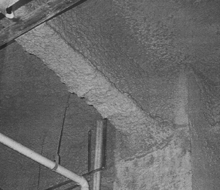
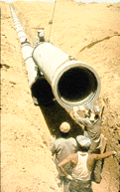
LOCATIONS OF ACM
Surfacing Material
TSI
Miscellaneous
PACM
Sample Inventory
Accredited Inspectors
Periodic Inspections
Notes:
Whether you realize or not, we encounter asbestos-containing material on a daily basis at ECU. As I mentioned earlier, asbestos is found in over 3,000 different building products including ceiling material, pipe insulation and flooring materials. However, asbestos is broken down into three categories: Surfacing material, Thermal System Insulation and Miscellaneous material. Surfacing material includes sprayed on ceiling material and fireproofing. Thermal System Insulation or TSI includes pipe and boiler insulation. Miscellaneous is everything else including floor tiles, ceiling tiles and transite material. So as you can see, suspect material is all around us but if you remember, the only way to positively identify asbestos is to have it analyzed by a lab. But, until it is analyzed we must presume that it is asbestos-containing material (ACM). The University has taken over a 1,000 samples to identify asbestos-containing material but we have not sampled every location on campus. Only accredited inspectors are allowed to take samples. They have to receive special training and pass a state certification exam. The University currently has 2 on staff who conduct sampling for small in-house projects. Our office maintains a database of all sample results and we have included an inventory in the University’s Asbestos Management Plan which summarizes these results. Locations which do not appear on this inventory must be presumed to contain asbestos. Areas where asbestos-containing material has been positively identified are periodically inspected to assure the integrity of the material is maintained.

Slide 9
SUSPECT MATERIAL
Before starting a project make sure that asbestos-containing material will not be disturbed
Assume all suspect material contains asbestos
Reference list/contact Safety
If you encounter suspect material when performing work STOP immediately and contact Safety Department before proceeding

Slide 10
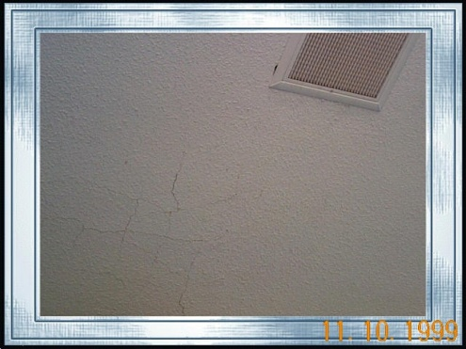
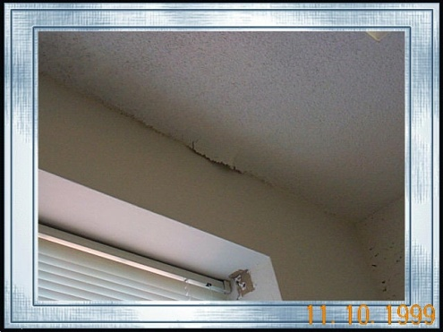
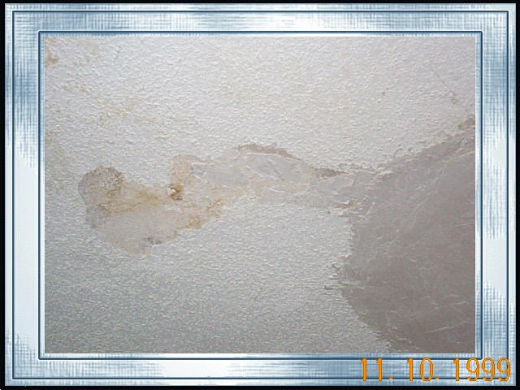
RECOGNITION OF DAMAGE
Friability
Water Damage
Delamination
Deterioration
Physical Damage
Minor Incidents
Major Incidents
Notes:
As I just said asbestos-containing material is periodically inspected by an accredited inspector to monitor the condition of the material to assure that the undisturbed condition of the material is maintained. However, these inspections occur only once a year in academic buildings and each semester in the Residence Halls so it is very important that you can identify damaged material so it can be addressed in a timely manner and thus minimize risk of exposure to you and other building occupants. The degree of friability will affect how easily a material can be damaged. Friability is the ease in which asbestos-containing material can be crumbled, pulverized, or reduced to powder by hand pressure. So, the more friable a material is, the more likely it is to become airborne. Ceiling material or this fireproofing material is friable material, in other words it can be easily damaged. Where as floor tiles would be classified as non-friable because it would take quite a bit of effort to damage. Damage can be in several forms including water damage (characteristic water ring), delamination (material has pulled away from the surface), general deterioration (aging) and physical damage (contact including gouge marks, etc). You should immediately report any damaged material to your supervisor who in turn should contact our office.

Slide 16
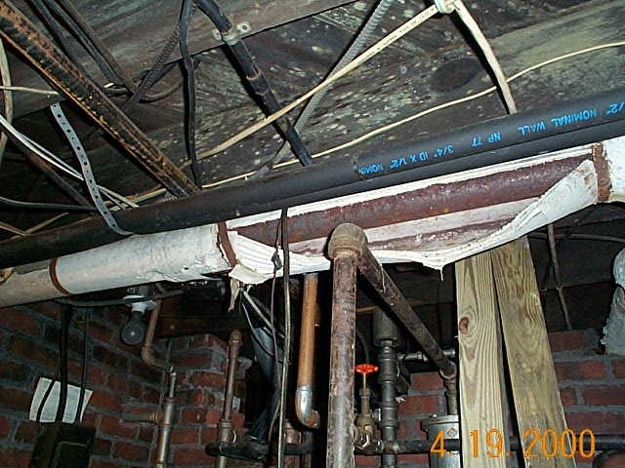

Slide 17
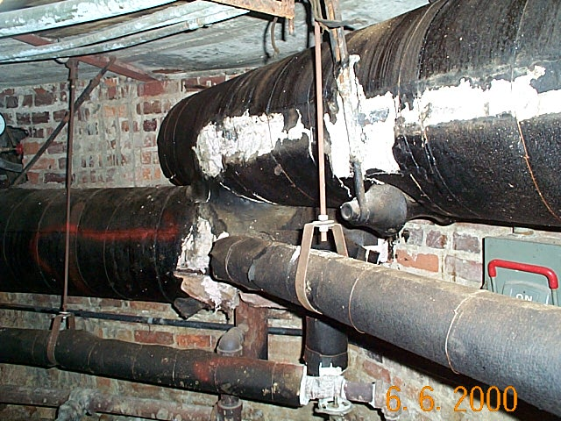

Slide 18
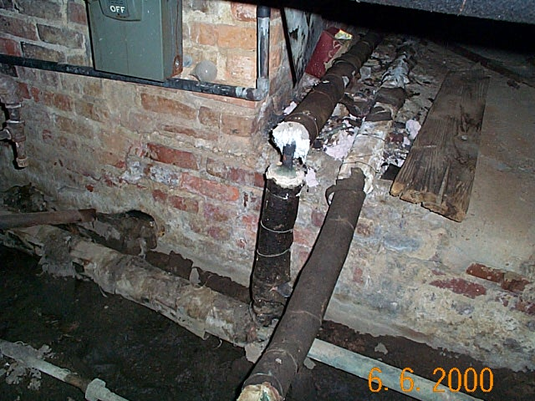

Slide 19
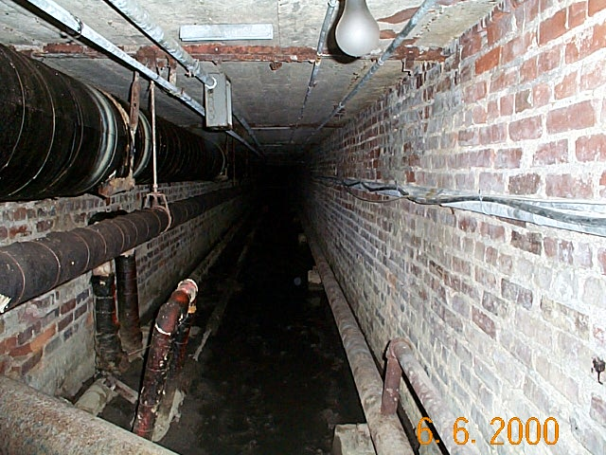

Slide 20
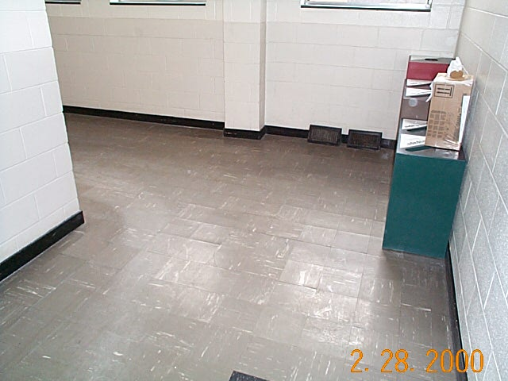

Slide 21
EMERGENCY PROCEDURES
Major Fiber Release (> 3 sq.ft)
Stop Work Immediately
Do Not Attempt Clean-up
Secure Area
Notify Supervisor
Contact Emergency Personnel
Do Not Reenter Area Until Instructed To Do So
Notes:
If you encounter a major fiber release you should take additional measures to protect yourself and other building occupants. A major release of asbestos fibers is defined as a release of greater than 3 square feet of material and could include a major release of asbestos fibers from water damaged ceilings, inadvertent disruption of ACM by maintenance staff, or pipe rupture. So, if you walk into a classroom that you know has asbestos-containing ceilings or you don’t know if they contain asbestos and there is a pile of ceiling debris on the floor then you should do the following immediately:
Stop work immediately and leave the area.
Do not attempt to clean up debris.
Secure the area by closing and locking the doors.
Notify your supervisor.
Contact the Environmental Health and Safety Office (328-6166) immediately. If the emergency occurs outside the normal working hours, contact ECU Police(328-6150).
Do not reenter the area until instructed to do so by the Environmental Health and Safety Office.

Slide 22
RULES AND REGULATIONS
OSHA
EPA
Harmon Electric, Inc. Policy
Notes:
There are many rules and regulations which we must comply with when dealing with Asbestos. I’m sure most of you have heard of OSHA (Occupational Safety and Health Administration) and EPA (Environmental Protection Agency). OSHA deals primarily with employee protection whereas the EPA covers air and water releases as well as proper disposal of asbestos waste. There is also a State Agency which governs how we manage asbestos. They are the NC Hazard Management Branch which is part of DENR. We also have a University Asbestos Management Program which includes policy and guidelines. This program is operated in accordance with applicable rules and regulations including the OSHA Construction Industry Standard for Asbestos 29 CFR 1926.1101, the OSHA General Industry Standard 29 CFR 1910.1001, the OSHA Respiratory Protection Standard 29 CFR 1910.34, the EPA National Emission Standards for Hazardous Air Pollutants (NESHAP) 40 CFR 61 Subpart M and the North Carolina Asbestos Hazard Management Legislation NC General Statute 130A, Article 19. The Environmental Protection Agency’s (EPA) documents, Guidance for Controlling Asbestos-Containing Materials in Buildings (the 1985 Purple Book) and Managing Asbestos In Place: A Building Owner’s Guide to Operations and Maintenance Programs for Asbestos-Containing Materials (1990) were also used in development of this program. These documents and other information concerning asbestos are available from the Office of Environmental Health and Safety located in Ragsdale 009.

Slide 23
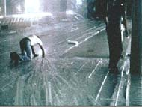
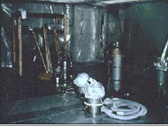
ABATEMENT ACTIVITIES
Encapsulation
Enclosure
Removal
Notes:
Occasionally asbestos material must be abated because of the condition of the material presents a significant health risk or because of a renovation or demolition. Asbestos abatement activities include removal, enclosure (airtight, impermeable, permanent barrier around asbestos-containing materials to prevent the release of asbestos fibers) or encapsulation (treatment of asbestos-containing materials with a material that surrounds or embeds asbestos fibers in an adhesive matrix to prevent the release of fibers, as the encapsulant creates a membrane over the surface or penetrates the material and binds its components together) of asbestos-containing material. All abatement activities must be performed in accordance with all applicable federal, state, and University rules and regulations and can only be performed by accredited personnel (received special training and passed certification exam).

Slide 24
Quiz
What is Asbestos?
Name 3 Building Materials That May Contain Asbestos?
Name 3 Diseases Associated With Asbestos Exposure?
When is Asbestos a Health Hazard?
What Greatly Increases the Risk of Lung Cancer?
What Should You Do If You Encounter PACM?

